Slide 1


Hospital DataBase Project
IITU
ERKANAT’s

Slide 2
WHY?
Hospital DataBase Project

Slide 3
who?
Mom -> DamuMed
Teacher ->DataBase
Superviser ->BackEnd

Slide 4

HOW?
It’s just old MySQL+NF
Actually 3006

Slide 5
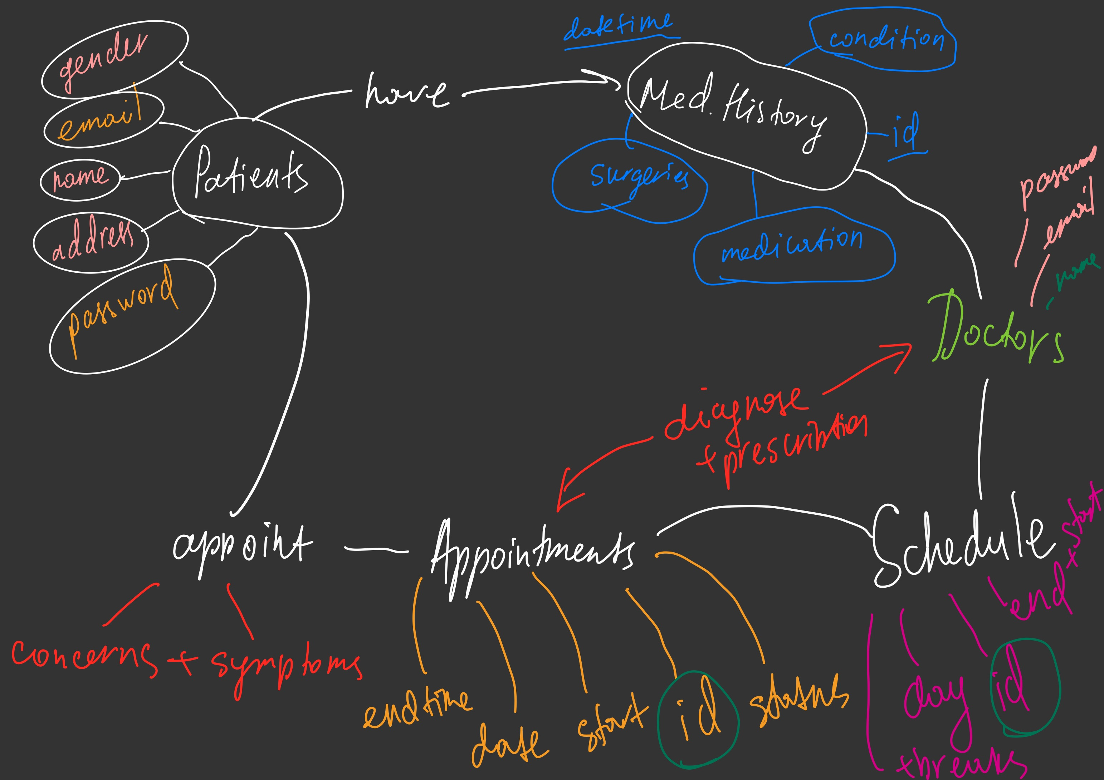
idea

Slide 6
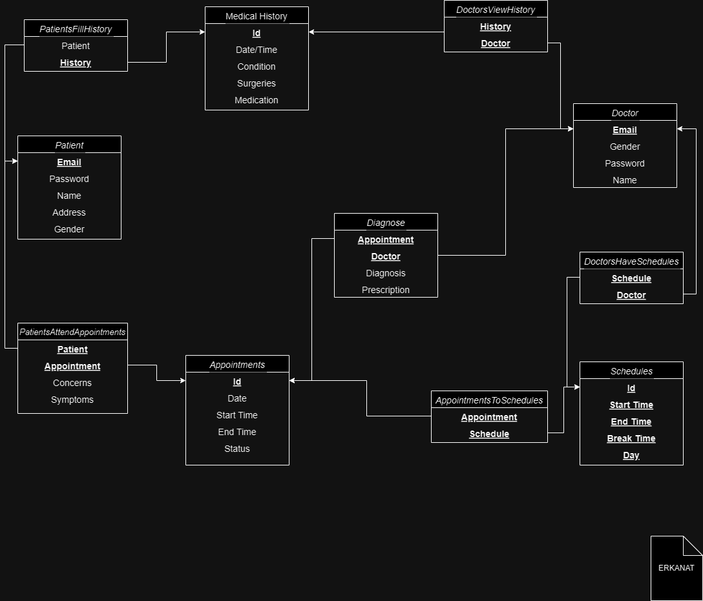
ER of ERKANAT

Slide 7
Thanks

